Slide 1
Probability & Statistical Modelling
AQ077-3-2-PSMOD and Version VD1
Concept of Probability

Slide 2
Topic & Structure of The Lesson
Introduction
Terminologies
Rules of Probability
Tree Diagram
Use of Venn diagram to solve probability
Contingency tables
Bayes’ Theorem

Slide 3
Learning Outcomes
At the end of this topic, You should be able to
Model /analyse simple business situations using
probability.

Slide 4
Key Terms You Must Be Able To Use
If you have mastered this topic, you should be able to use the following terms correctly in your assignments and exams:
Addition Rule
Mutually Exclusive
Not mutually exclusive
Multiplication Rule
With Replacement
Without Replacement
Independent events
Dependent events
Probability tree diagram
Conditional Probability

Slide 5
Introduction
Probability is the likelihood or chance of something happening.
In an experiment in which all outcomes are equally likely, the probability of an event E is

Slide 6
(e.g. we might say that there is a 80% chance or 0.8 chance that outcome A will happen; we would then implying that there is a 20% or 0.2 chance that A would not occur.)
In Statistics , probabilities will be more commonly expressed as proportions than as percentages.

Slide 7
0 ≤ p(E) ≤ 1
If P(E) = 0, E is called an impossible event
If P(E) = 1, E is called a certain event.
The sum of the probabilities of all the outcomes of an experiment must total 1.
P(E does not occur) = 1 – P(E)
(Complementary probability)

Slide 8
Terminologies
Statistical event
it is defined as any subset of the given outcome set that is of interest
Statistical experiment
it is described as any situation , specially set up or occurring naturally, which can be performed, enacted or otherwise considered in order to gain useful information

Slide 9
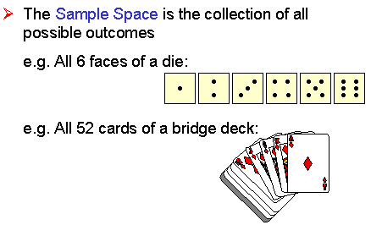
Sample space

Slide 10
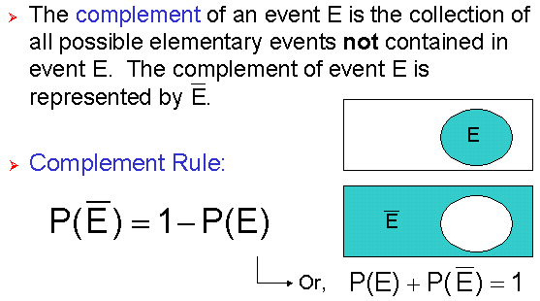
Complement Rule

Slide 11
Example 1.1
A group of 20 university students contains eight who are in their first year of study. A student is picked at random. Find the probability that the student is not in the first year of study.

Slide 12
Probability Rule for Combined Events
P(A ∪ B) = P(A) + P(B) – P(A ∩ B)

Slide 13
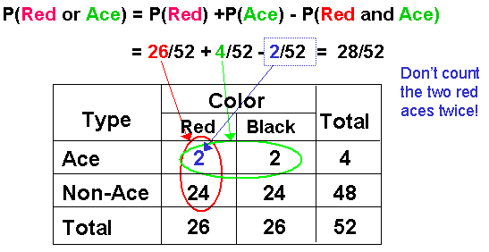
Quick Review Question
Example 1.2
If a card is drawn from a deck of playing cards, what is the probability of getting a red or an ace?

Slide 14
Example 1.3
In a class of 20 children, 4 of the boys and 3 of the eleven girls are in the athletics team. A child from the class is chosen at random. Find the probability that the child chosen is
(a) in the athletics team
(b) a girl
(c) a girl member of the athletics team
(d) a girl member or in the athletics team.

Slide 15
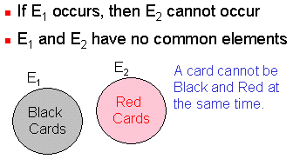
Mutually exclusive events
Two events of the same experiment are said to be mutually exclusive if their respective events do not overlap.

Slide 16
Not mutually exclusive
If two or more events occur at one time.
Independent events
Two events are said to be independent if the occurrence (or not) of one of the events will in no way affect the occurrence (or not) of other.
Alternatively, two events that are defined on two physically different experiments are said to be independent.

Slide 17
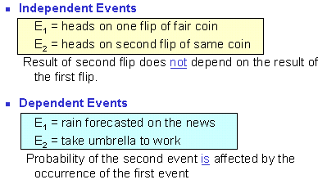

Slide 18
Example 1.4
In a race in which there are no dead heats, the probability that John wins is 0.3, the probability that Paul wins is 0.2 and the probability that Mark wins is 0.4. Find the probability that
(a) John or Mark wins.
(b) John or Paul or Mark wins.
(c) someone else wins.

Slide 19
Example 1.5
A card is drawn from a bag contains 5 red cards numbered 1 to 5 and 3 green cards numbered 1 to 3. Find the probability that the card is
(a) a green card or a red card,
(b) a green card or an even number.

Slide 20
Conditional event
one of the outcomes of which is influenced by the outcomes of another event.
If A and B are two events not necessarily from the same experiment, then the conditional probability that A occurs, given that B has already occurred, is written
P(A, given B) = P(A|B) =
P(B, given A) = P(B|A) =

Slide 21
Example 1.6
When a die was thrown, the score was an odd number. What is the probability that it was a prime number?

Slide 22
Example 1.7
In a certain college,
65% of the students are full time students
55% of the students are female
35% of the students are male full time students.
Find the probability that a student chosen at random
(a) from all the students in the college is a part time student.
(b) from all the students in the college is female and a part time student.
(c) from all the female students in the college is a part time student.

Slide 23
Rules of Probability
Addition Rule
Multiplication Rule

Slide 24
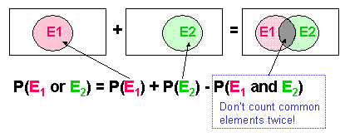
General Addition Principle
If E and F are not mutually exclusive events, then
P(E₁∪E₂) = P(E₁) + P(E₂)-P(E₁∩E₂)

Slide 25
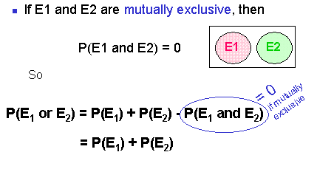
Rule of Addition
(i.e.the probability that either E₁ or E₂ occurs is the probability that E₁ occurs, plus the probability that E₂ occurs)

Slide 26
Rule of multiplication
If A and B are two events, then the probability of
P(A and B), i.e. probability that A and B occur can be calculated as below:
Probabilities under conditions of statistical independence
P(A and B) = P(A) x P(B)
Probabilities under conditions of statistical dependence
P(A and B) = P(A) x P(B\A)
Probability of event B given that A has occurred
P(B|A) =

Slide 27
Example 1.8
A fair die is thrown twice. Find the probability that two fives are thrown.
Events A & B are independent and P(A) = 0.3, P(A ∩ B) = 0.12. Find P(B) and P(A ∪ B).

Slide 28
Example 1.9
The events A and B are independent and
P(A) =x, P(B) = x + 0.2 and P(A ∩ B) = 0.15.
(a) Find the value of x.
(b) P(A ∪ B)
(c) P(A’ | B’ )

Slide 29
Example 1.10
Three people in an office decide to enter a marathon race. The respective probabilities that they will complete the race are 0.9, 0.7 and 0.6. Assume that their performances are independent. Find the probability that
they all complete the race.
none complete the race.
at least one completes the race.

Slide 30
Tree Diagrams
Tree diagram
It augments the fundamental principle of counting by exhibiting all possible outcomes of a sequence of events where each event can occur in a finite number of ways.

Slide 31
Example 1.11
In a certain selection of flower seeds, 2/3 have been treated to improve germination. The seeds which have been treated have a probability of germination of 0.8, whereas the untreated seeds have a probability of germination of 0.5.
(a) Find the probability that a seed, selected at random, will germinate.
(b) Find the probability that a seed selected at random had been treated, given that it had germinated.

Slide 32
Example 1.12
Marie is getting married tomorrow, at an outdoor ceremony in the desert. In recent years, it has rained only 5 days each year. Unfortunately, the weatherman has predicted rain for tomorrow. When it actually rains, the weatherman correctly forecasts rain 90% of the time. When it doesn't rain, he incorrectly forecasts rain 10% of the time. What is the probability that it will rain on the day of Marie's wedding?

Slide 33
Venn Diagram
When events are not mutually exclusive, Venn diagram is useful.
Note that when completing a Venn diagram , it is essential to deal with the overlap area first.

Slide 34
Example 1.13
A group of 50 people was asked which of the three newspapers A, B or C they read. The results showed that 25 read A, 16 read B, 14 read C, 5 read both A and B, 4 read both B and C, 6 read C and A and 2 read all three.
(a) Represent these data on a Venn Diagram.
Find the probability that a person selected at random from this group reads
(b) only A.
(c) only one of the newspaper.
(d) at least one of the newspaper.

Slide 35
Contingency Tables
A table used to classify sample observations according to two or more identifiable characteristics
It is a cross tabulation that simultaneously summarizes two variables of interest and their relationship.
Example:
A survey of 150 adults classified each as to gender and the number of movies attended last month. Each respondent is classified according to two criteria –the number of movies attended and gender.
Gender
Movies Attended
Men
Women
Total
0
20
40
60
1
40
30
70
2 or more
10
10
20
Total
70
80
150

Slide 36
Posterior Probability
Bayes Theorem
It is a formula which can be thought of as ‘reversing’ conditional probability. That is , it finds a conditional probability (A\B) given, among other things, its inverse (B\A).
If A and B are two events of an experiment, then
P(A\B) =

Slide 37
Solution for example 1.12
P(R) = 5/365 P(R') = 360/365
P(F|R) = 0.9 P(F|R') = 0.1
Applying Bayes' Theorem:

Slide 38
Summary of Main Teaching Points
Recall
What is Probability ?
Rules of Probability
Using
Tree Diagram
Venn Diagram
Contingency table
to solve the questions on Probability
Conditional Probability & Posterior Probability

Slide 39
Question and Answer Session
Q & A

Slide 40
What we will cover next
Summary Measures of Statistics

